Slide 1



Arbitration Procedure and Writing an enforceable Arbitral Award.
Uganda Law Society
Continuing Legal Education
Golf Course Hotel
12th December 2017.
David Kaggwa,
FCIArb, FICCP
LLM (Construction Law & Arbitration) RGU Arberdeen

Slide 2

Profile
David Kaggwa,
FCIArb, FICCP
LLM (Construction Law & Arbitration) RGU Arberdeen
Current Positions:
Chairman, Chartered Institute of Arbitrators – Uganda Chapter.
Director, Chartered Institute of Arbitrators – Kenya Branch.
Executive Director, Construction Law Institute.
Senior Partner, Kaggwa & Kaggwa Advocates.
Memberships:
Fellow: Chartered Institute of Arbitrators (FCIArb)
Fellow: Institute of Construction Claims Practitioners (FICCP)
Member: Society of Construction Law (UK)
Member: London Court of International Arbitration (LCIA)
Member: International Center for Mediation & Arbitration in Kampala (ICAMEK)
Member: Center for Arbitration & Dispute Resolution
Member: International Bar Association.
Member: Uganda Law Society and East Africa Law Society

Slide 3

Appointment of an Arbitrator
S. 11 of the Arbitration and Conciliation Act provides that the parties are free to agree on the procedure of appointing the arbitrator.
In case of failure to agree, the appointing authority shall make such appointment and his decision is final and not subject to appeal.

Slide 4
Checklist before Accepting Appointment
Ask for copies of the Notice of Arbitration and the contract, checking that there is an appropriate and valid arbitration clause.
Determine whether there is a conflict of interest.
Whether the arbitrator is sufficiently available to take up the nomination.
Whether you have the required expertise, technical and or legal knowledge in a particular field.

Slide 5

Checklist before Accepting Appointment
If it is a technical dispute, whether the arbitrator is familiar with and up-to date on its technical aspects.
If the enquirer is a party, the would-be arbitrator should send his cv and general terms and conditions for agreement.
If the enquirer is an appointing body, the arbitrator should either agree or decline it.

Slide 6
Preliminaries
If you are an advocate or other representative for a party, you will want to make sure that the procedure will be as appropriate and advantageous as possible to your client.
If you are the arbitrator, you will be the one to manage the process.
Parties are free to agree on the procedure for the arbitration. It may be contained in the arbitration clause or the procedure may be agreed upon by holding a preliminary meeting with the parties and their representatives.

Slide 7

Preliminaries
Prior to the preliminary meeting, the Arbitrator sends to the parties’ representatives an agenda which should list all the possible matters required for decision as to the procedure to be followed in that arbitration.
It is advisable to have a complete agenda at the outset if only to show the parties that the Arbitrator knows his business and is prepared to put it into practice to suit this dispute best.

Slide 8
Professional Fees and expenses
Acceptance fee: (non-refundable, to include up to 10 hours preliminary reading);
Additional hours worked excluding Hearings: (including travelling time, reading documents, correspondence, preparation of Orders and Awards):
Hearings: (including procedural meetings, interlocutory hearings, hearings on substantive matters
Cancellation Charges: where a specific day or days have been arranged for meeting or hearing and have been cancelled for whatever reason.

Slide 9

Professional Fees and expenses
Travelling.
Expenses and disbursements.
Fee Notes: interim charges shall be invoiced periodically, e-mailed or delivered to the parties, payable within 14 days of the date they are e-mailed or delivered. All outstanding charges payable on taking up the Final Award or 10 days after notification that it is ready for collection, whichever is the earlier.
The parties shall be jointly and severally liable for any and all charges and fees.

Slide 10
Conducting the Hearing
The Arbitrator is the master of ceremonies and he should open the Hearing by introducing himself formally and setting the ground rules.
He should then ask the parties and their advocates to introduce themselves and any other people such as witnesses.
If there is any doubt in his mind, the Arbitrator should ask the parties to vouch for the presence of anyone not clearly identified, asking any remaining unknowns to explain their presence and, if appropriate, ask them to leave.
This is a private matter.

Slide 11

Interlocutory applications
S. 16 of the Act, the tribunal can rule on its jurisdiction.
Amendments to pleadings.
Security for costs, in case a party defending a claim feels that its claimant may not be able to pay the costs of the arbitration if the claim is unsuccessful, that responding party can consider applying to the tribunal for security for these costs.

Slide 12

Settlement
In case the parties agree to settle the dispute before the hearing, then the parties have a choice as to whether they ask the Arbitrator to write up their agreed terms settling their dispute in an Agreed Award (or ‘Consent Award’) or just inform the Arbitrator that they have settled and that they no longer require his services.

Slide 13
Characteristics of an arbitral award
Analyse the dispute and issues from the evidence.
Be enforceable
Be certain and capable of performance
Be clear and unambiguous
Deal with all the pleaded issues
Comply fully with the submission (that is, the arbitration agreement)
Decide on all the evidence adduced, no more and no less.

Slide 14

Types of Awards
An interim (or partial) Award is one that does not dispose of all the matters in dispute but it does dispose finally of those matters which it decides.
Rules on a preliminary point of law.
Liability then quantum.
Substantive matters before costs
Declaratory.
A final award is the Arbitrator’s last act and ends the arbitration. An arbitrator’s function ceases with a final Award; he is said to be functus officio – he is no longer an Arbitrator.

Slide 15
Formal Requirements of an Award
The award must be in writing and signed by the arbitrator.
Your appointment should be noted, listing the letters exchanged which may include further agreements between the parties as to your powers or restrictions as their arbitrator (such as to decide the dispute according to ‘equitable principles’ rather than strict law).
The contract should be clearly identified in the Award as should its arbitration clause or agreement.
As the arbitration clause is the major source of your authority and as it probably refers to ‘dispute’ or ‘difference’, you should note that either or both of these have arisen, otherwise you may not have the necessary jurisdiction to make your Award.

Slide 16
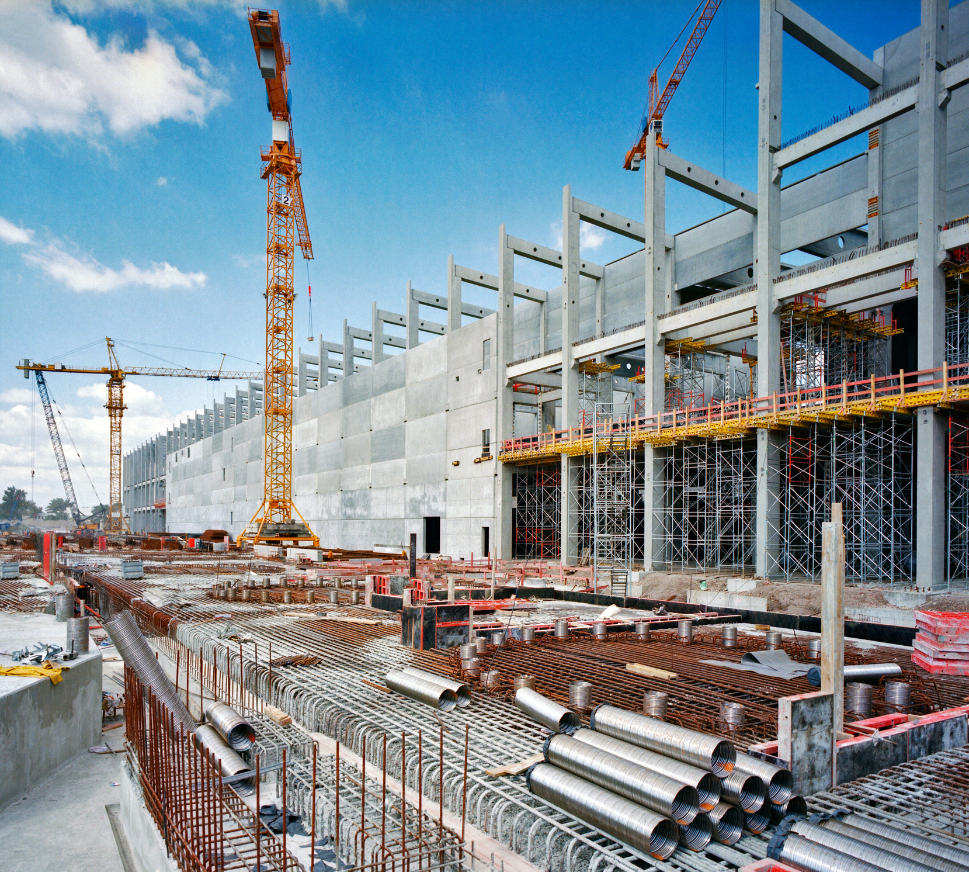
Formal Requirements of an Award
Location. The location (seat) is also important in case the Award is to be enforced in another jurisdiction, under some convention or treaty or, more usually, the ‘New York’ Convention of 1958.
The details of the dispute need to be listed, from the contentions of the parties in their submissions, followed by the details of the proceedings, interlocutory matters and any hearings of evidence including the parties’ representatives and the witnesses they called, divided between witnesses of fact and experts.
Award must have reasons unless the parties expressly agree to dispense with reasons.

Slide 17
Formal Requirements of an Award
You should state who are the parties; identify them precisely. If this is not done, your Award will be unenforceable because it is uncertain.
Your recitals should list all the agreed facts and details of the dispute, to set the scene for your Award.
You take note of all the evidence and submissions, ‘find’ the facts that are disputed, ‘hold’ your opinion as to the application of the law to those facts, consider liability then quantum and, finally, make your decision on each and every issue put to you. You then summarise all these decisions.
The date is important for many reasons, mostly because of the time available for an application to set it aside but also because interest on the Award is likely to start then.

Slide 18

Attributes of an Enforceable Award
C C C F
Cogent – forcefully convincing
Complete – all matters submitted for decision
Certain – unambiguous & consistent ; It must not have more than one interpretation, it must be consistent (both in itself and with all other Awards in that arbitration) and it must clearly be within the arbitration agreement.
Final – all issues addressed Enforceable
In case an award does not assess the costs, any party
can apply to the court to have this done. [Okello Ocero
v Top Rate Construction Ltd, per Geoffrey Kiryabwire J
(as he then was).

Slide 19
Conclusion
In writing an award, an arbitrator should write it for 4 people.
The Loser.
The Winner.
The Court before which the award is taken for
challenge or enforcement.
4. Yourself.

Slide 20




Thank You!
Contact:
0700 521 398 / 0789 519 111 / 0700 597 888
Email:
info@constructionlawinstitute.com
Follow us

