Slide 1

INTRODUCTION TO MEDIATION
Presented by: Olivia Kyarimpa Matovu, MCIArb
Partner – Ligomarc Advocates & Hon. Treasurer – CIArb Uganda Chapter.
DATE: 06/09/2024

Slide 2

ESSENTIAL SKILLS AND TECHNIQUES FOR AN EFFECTIVE MEDIATION
Presented by: Asmahaney Saad CHM (MTI – EA) MCIArb – UK
Managing Partner – KTA Advocates
DATE: 06/09/2024

Slide 3

RELEVANCE OF MEDIATION TO UGANDA REVENUE AUTHORITY
Presented by: Belinda Lutaya Nakiganda, MCIArb
Partner – Birungyi, Barata & Associates and Hon. Deputy Secretary, CIArb – Uganda Chapter
DATE: 06/09/2024

Slide 4

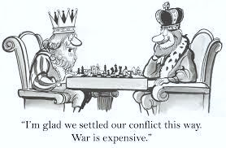
WHAT IS ALTERNATIVE DISPUTE RESOLUTION?
Alternative Dispute Resolution (ADR) is any means of settling disputes outside of the courtroom.

Slide 5
WHAT IS ALTERNATIVE DISPUTE RESOLUTION?
Voluntary facilitated process of settling tax disputes between a tax payer and the Commissioner where the tax payer is disatified with Commissioner’s decision. R.2 Tax Procedure Code(Alternative Dispute Resolution Procedure) Regulations 2023

Slide 6
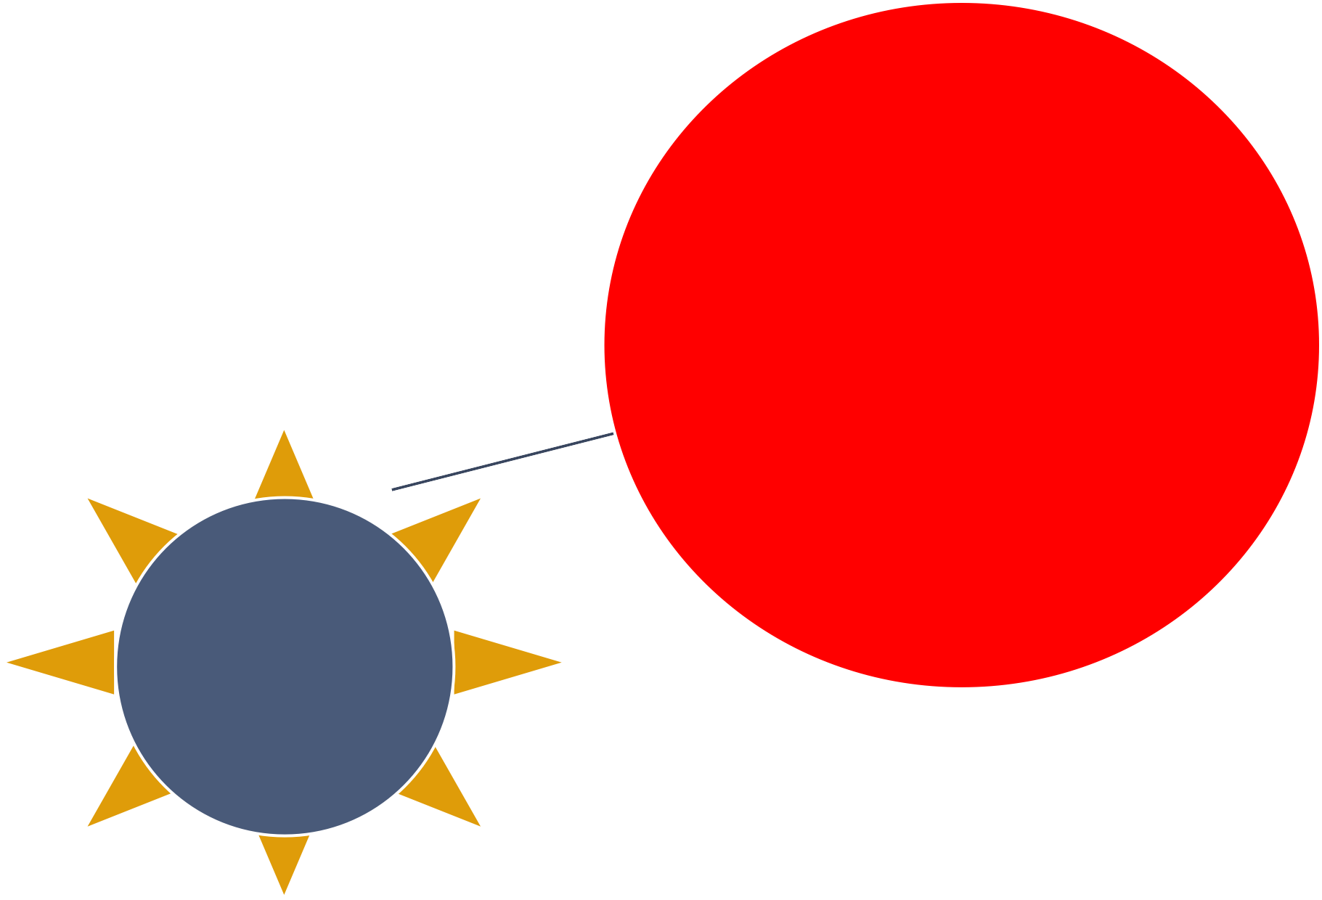
NEGOTIATION ARBITRATION MEDIATION CONCILIATION
FORMS OF ADR

Slide 7
ADR in Tax Disputes
S.26(11)- Tax Procedure Code Act Cap. 343
TPC(ADR Procedure) Regulations
A tax payer dissatisfied with CG’s tax decision applies for ADR
Application filed within 7 days from date of tax decision
ADR process does not affect timelines for filing at TAT

Slide 8
Mediation
Mediation is the process by which a neutral third person facilitates communication between parties to a dispute and assists them in reaching a mutually agreed resolution of the
dispute.- S.3 Judicature (Mediation) Rules, 2013. Art.1(2) UNCITRAL Mediation rules
Mediation is an informal, voluntary and confidential process in which parties to a dispute can, with the help of an independent intermediary, meet to work out a settlement – Stephen Walker and David Smith in their book- Advising and Representing Clients at Mediation

Slide 9
Principles of Mediation
Party Autonomy
Confidentiality
Flexibility
Legal Privilege
Neutrality & Impartiality
Fairness

Slide 10
The mediation process
There are four main stages of Mediation
Introduction
Story Telling(Advocacy phase)
Problem solving
Agreement writing(negotiation phase)

Slide 11

Stage 1- Introduction
Name of Mediator & Background
Names of Parties
Ground Rules
Stage 2- Story telling
Each Party states their case

Slide 12

Stage 3- Problem solving
Mediator facilitates parties’ solution finding.

Slide 13
caucus
The mediator shares ideas with each of the parties alone in single sessions.
can encourage parties to explore the ‘what ifs’ of a situation
make appeals to a single party to adopt more realistic goals
discover limits of each party’s position
clarify the other party’s position
Provide an opportunity for each party to express feelings and thoughts

Slide 14

Stage 4- Writing an agreement (Role of Advocate is critical here)
Terms of the agreement reduced into writing
Settlement agreement must be signed by the parties
Mediator to Endorse settlement agreement
Settlement Agreement binding and enforceable
- As a contract in private mediation
- As Consent Judgement in Court annexed mediation
- As International settlement agreement under Singapore Mediation Convention

Slide 15


Types of Mediation
Court Annexed Mediation:-
Judicature (Mediation) rules 2013
S.18(1) & (2) TAT Act Cap 341
Private mediation
Contractual – domestic mediation
Contractual – international mediation:- UNICTRAL Mediation Rules
& Singapore Mediation Convention

Slide 16
Styles of Mediation
Facilitative Mediation
Mediator facilitates parties to determine their own solution without making recommendation/suggestions
Evaluative Mediation
Mediator makes recommendations and suggestions on settlement of dispute

Slide 17

This refers to formal discussions in which people or groups try to reach an agreement.
There are four possible outcomes to a negotiation
I WIN
I LOSE I LOSE
←→ YOU LOSE
←→ YOU WIN
←→ YOU LOSE
WE BOTH WIN!!

Slide 18
Styles of Negotiation
The extrovert style
Inductive style.

Slide 19







Key Negotiation Techniques and practices
1.Create the right environment
3.
Opening the negotiation
5.
Making proposals
7.
Summarizing, closing and confirming
4.
Personal communications
2.
6.
Have a plan
Timing

Slide 20

Creating the right environment
Creating the right atmosphere
Choosing the right time to negotiate
Selecting the best place

Slide 21

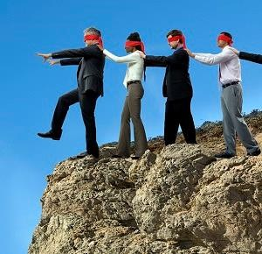
HAVE A PLAN
Prepare a list of objectives and use it
Without a plan, you
are bound to fall
Provide for trading-off concessions from your negotiating partner.

Slide 22
Opening the negotiation
What needs exist?
What areas of common ground exist between us?
What is the history/track record of the
relationship?
How much authority does my negotiating partner have?
What is their “power” over us and / or our competitors?
How can we exploit our strength for mutual benefit?
Consider the following;

Slide 23
Making proposals
Ask assertive questions such as, “how can you justify your position?”
This may draw your negotiating partner to reveal his or her arguments and aims in negotiations.
This may also expose any conflict and difficulty he or she is facing in reaching an agreement.

Slide 24
Summarizing, closing and Settlement Agreement
Summaries help to clarify proposals and the terms of agreement. A typical signal of a summary is the word-: “So”
Confirm points of agreement before leaving the negotiations
by;
Taking and exchanging notes
Getting the agreement in writing
Checking that the minutes and your negotiating partner's notes agree with your notes
Paying meticulous attention to the small print and foot notes.
Prepare Settlement Agreement:_
R.13(1) & (2) & R.14:- settlement Agreement binding on CG and tax payer & is enforceable in court.

Slide 25
Question
What ADR method is adopted under the Tax laws?

Slide 26

ESSENTIAL SKILLS AND TECHNIQUES FOR AN EFFECTIVE MEDIATION
Master the art of effective mediation
Highlight the qualities of an effective mediator
Skills and techniques we should apply to achieve an effective mediation process
Examine a scientific approach to effective mediation- The Six Thinking Hats method.

Slide 27

WHAT IS AN EFFECTIVE MEDIATION?
Mediation is one of the most effective methods of preventing, managing, and resolving conflicts. An effective mediation process responds to the specificity of the conflict. It considers the causes and dynamics of the conflict, the positions, interests, and coherence of the parties, and the needs of the broader society, which may be impacted by the outcome, to ensure sustainability.
A well-trained and experienced Mediator, therefore, becomes an essential resource for an effective mediation process by ensuring;
There is consent by both parties to the process
Adequate planning and preparation for the process.
Manage time allocated to each session.
Parties are well-informed and guided throughout the process.
The mediator ensures that the process is fair and transparent, fostering a sense of security and trust among all parties involved.

Slide 28
QUALITIES OF AN EFFECTIVE MEDIATOR
Impartiality- There should be no preference for resolving the matter.
Flexibility is key in mediation. It allows the mediator to be open to the parties' options, fostering a collaborative atmosphere and enabling the exploration of various solutions.
Objectivity is crucial in mediation. It ensures that the mediator is not swayed by the parties' emotions, enabling them to make unbiased decisions and maintain the integrity of the process.
Articulate: Be confident in speech and thought process
Emphatic: The mediator should be able to appreciate the perceptions, fears, history, and thoughts that underlie each party’s proposals but not sympathise.
Creative. Mediation is meant to help parties who cannot negotiate by themselves to find a solution. No one size fits all

Slide 29
ESSENTIAL SKILLS FOR EFFECTIVE MEDIATION.
Communication skills. Communication is simply the process of transmitting or conveying facts, ideas, feelings, thoughts by one person to another. For communication to be effective it must be carefully planned and structured.
This means you should have a purpose in mind, the people you are talking to find your talk meaningful, use clear, direct and simple words, you have to confirm that you have been understood, do not only talk but also listen to others and be informed and well informed.
Listening skills. All of us listen but we do not hear! Why? Because we do it badly. Listening means the ability to accurately receive and interpret the messages in the process of communication. A listener must first hear what is being said, then select and identify important points and then store it in the memory.
Negotiation skills. It can be defined as the art of finding an agreement which can bring to an end a dispute between disputants. It is a means by which parties compromise and agree on the way forward about a difference. Its all about a give and take.

Slide 30
Con’t
Negotiation has many possible outcomes but the most desirable is the I win: you win where none of the parties to the dispute loses. Both parties generate options and move forward to a settlement.
Building Rapport and Trust. Building rapport and trust is crucial in any mediation process. A mediator needs to create an environment where parties feel comfortable expressing their thoughts and concerns. Establishing trust allows for open communication, enabling parties to work towards a resolution effectively. The mediator’s impartiality and empathy play a significant role in building this trust.
By using the above skills in addition to the required qualifications of a mediator, they are able to ensure that the mediation process is effective.

Slide 31

EFFECTIVE TECHNIQUES FOR EFFECTIVE MEDIATION
The success of mediation will depend on the mediator's ability to control the entire process. During the sessions, parties can easily get emotionally charged, and power plays, walk-aways, and power imbalances can be witnessed.
In such a situation, the mediator can use the following techniques among others;
Using clarifying questions but not too much.
Acknowledging gestures.
Paraphrasing statements.
Summarizing what the party has said in simple language.
Collecting important information.
Empathizing with each party.

Slide 32
Dr. Edward de Bono created a system known as the Six Thinking Hats, which is grounded on the idea that the brain thinks in many different ways that can be interpreted and accessed to achieve effective problem-solving.
He explains that there are six ways that parties to a dispute can approach a problem to solve it. Using the analogy of the six hats/ coloured hats, a mediator can encourage the parties to consider their issues from different perspectives and help them move forward.
By understanding first what hat each party is wearing to the dispute, he can navigate his approach to getting the parties to see each one’s point of view.
A mediator can then switch his hat to correspond to the interpretation at that time, while moving the parties towards a win–win solution, fostering an optimistic outlook for the resolution process.
https://youtu.be/W3aWduLGM5I?si=pYyzDF2Kjnb2ZdNS
THE SCIENTIFIC APPROACH TO MEDIATION- THE THINKING METHOD

Slide 33

THE SIX THINKING HATS TECHNIQUE
1. White hat
The white hat is used at the beginning to consider facts, figures, and other information needed to understand the dispute. It is also used to collect information at the end of the thinking process. If a mediator wants parties to think about facts, he can ask them to put on a white hat.
2. The red hat
The red hat represents feelings, hunches, and intuition, and is worn by those who rely on their instincts to tackle problems. It encompasses an emotional response to the situation, a factor that holds equal importance in dispute resolution. When a mediator seeks to understand the emotional state of the disputing parties, he will prompt them to wear a red hat.
3. Black hat
It is used to discover potential risks and downsides and is useful to determine solutions that are most practical and likely to work. It helps answer questions as to why something may not work. A mediator will ask the disputants to wear a black hat when he wants them to think of objective reasons as to why something cannot be done, could go wrong, or why they should be cautious.

Slide 34
4. Yellow hat
It is used to look at the situation from the most positive aspect possible. It symbolizes brightness and optimism. It encourages positive thinking, kindles hope and draws the thinker close to putting ideas into use and makes parties to look for values to the proposals offered.
5. Green hat
This is a creative hat, also called the energy hat. When worn, it focuses on possibilities, alternatives, and new ideas. Parties to a dispute use it to create new ideas. When a mediator asks the parties to think of new ideas, options, and explanations or to see the problem from a different perspective, he is basically asking them to wear the green hat.
6. Blue hat
It is used to manage the thinking process or to see the bigger picture. When used, it also indicates coolness. Visualize the blue hat by considering an overview from the sky above. It provides an aerial view of the problem. It is the main hat and is mainly worn by the mediator himself.

Slide 35
SUMMARY OF THE THINKING HATS
Green hat – creativity
White hat – information
Blue hat – focus
Red hat – emotions
Black hat- caution
Yellow hat - benefits

Slide 36

CONCLUSION
Effective mediation means that at the end of the process, the disputants have resolved their problems with the mediator as a neutral party. Not every mediation is successful or even effective.
Therefore, we must intentionally apply the right skills and techniques essential to resolving the conflict.

Slide 37
OVERVIEW OF THE LAW
Tax Procedure Code Act
Tax Procedure Code Act Regulations/Public Notice August 2023
ADR is voluntary to the Taxpayer
Refers to Regulations
S.24 (11)
Apply within 7 days from the date of the decision
The taxpayer proposes the method preferred (mediation, settlement, Negotiation and conciliation)
Apply within 7 days from the date of the decision
URA responds to taxpayer.
There is no timeline. (R.4,5)

Slide 38
MEDIATION BEFORE TAX APPEALS TRIBUNAL
OBJECTION DECISION / FAILED ADR AT URA
TAXPAYER FILES APPLICATION TO THE TRIBUNAL
MEDIATION

Slide 39
IMPORTANCE OF MEDIATION TO URA
Collaborative between URA and Taxpayer
Confidential as some taxpayers like handling matters in private
Flexibility and parties take control of the process

Slide 40
Cont.
Understanding: Parties know more about each other's positions, reconciliation
Saving costs and time to both the Taxpayer and URA

Slide 41


