Slide 1


The Art of Drafting Arbitral Awards.
David Kaggwa, FCIArb, FICCP.

Slide 2

Commencement of Arbitration

Slide 3

Commencement of Arbitration
S. 21 of the Arbitration and Conciliation Act
Unless the parties agree, the arbitral proceedings in respect of a particular dispute shall commence on the date on which a request for the dispute to be referred to arbitration is received by the respondent.
S. 6. of the ACA, Interim measures by the court.
A party to an arbitration agreement may apply to the court, before or during arbitral proceedings, for an interim measure of protection, and the court may grant that measure.

Slide 4

Preliminary Meeting

Slide 5
Preliminary Meeting
The Arbitrator should issue Summons for the Preliminary Meeting to the parties and attach an agenda.
The management of the procedure relating to the arbitration proceedings passes from the parties to the tribunal, but the parties retain their autonomy.
To establish a framework for the proceedings as soon as possible.
A preliminary meeting can be conducted physically or virtually.
Each party should be represented at the preliminary meeting by persons with authority and knowledge to make decisions.

Slide 6
Checklist
Agreement to adopt procedural rules if not agreed.
The language of the proceedings.
The need (if any) for translation of oral presentations and documents and the costs involved;
The place of the arbitration and its implications if the parties have not already decided upon the place;
The possibility of holding hearings outside the place of the arbitration;
Administrative services: if an institution is not administering the arbitration.
The arbitral tribunal may appoint an Arbitration Secretary.
Deposits on the Arbitration fees and expenses.

Slide 7
Checklist
Confidentiality of information.
Agreement on the mode of communication.
The exchange of pleadings, content, and timetable.
Terms of reference with the issues are to be signed by the parties.
Settlement negotiations should be considered through other forms of ADR/MedArb/Expert Determination.
The arbitral tribunal may set time limits for document submission and determine the consequences of late submission.
The procedure for the discovery of documents.
The arbitral tribunal may make arrangements for any physical evidence to be presented as well as any site inspections it may wish to undertake;

Slide 8
Checklist
The arbitral tribunal may determine how the hearing of witnesses will take place.
The arbitral tribunal may wish to consider appointing an expert to report to it;
Determine how the expert is to be chosen;
Define the terms of reference for the expert and
How the parties are to comment on such terms of reference;
The arbitral tribunal may wish to decide whether the hearings will be held if they are to be held, and how they will be structured.
Determine whether the evidence is oral or by witness statements.
Submissions.
Prepare a Trial Timetable and annex to Procedural Order No. 1.

Slide 9

Interlocutory Matters

Slide 10
Interlocutory Matters
There may be some fundamental issues that the arbitral tribunal may need to address at an early stage of the arbitration to avoid disputes arising before or after the Award.
Jurisdiction;
The law governing the arbitration;
The law applicable to the substantive issues between the parties.
Whether the dispute is Arbitrable.
Validity of the Arbitration Agreement.

Slide 11

Bifurcation

Slide 12
Liability v Quantum.
The arbitral tribunal may consider whether liability and quantum should be dealt with separately.
In some complex cases, it may often be convenient for the arbitral tribunal to determine questions of liability first.
In this way, the parties avoid the expense and time involved in submitting evidence and arguments on detailed aspects of quantification that may be irrelevant following the arbitral tribunal’s decision on liability.
The determination of specific factual issues relating, for example, to whether the respondent should have been granted an extension of time such that there would be, in fact, no delay and hence, no liquidated damages payable would then become irrelevant.

Slide 13
Procedural Orders

Slide 14
Procedural Orders.
The tribunal should issue written directions as soon as practicable after the preliminary meeting regarding the matters that it has directed the parties to comply with so that the arbitration can progress to a hearing.
The tribunal would have guided the parties towards agreement on the procedural steps to be taken and a timetable.
Where the parties cannot agree on certain matters, the tribunal would have to take control and issue appropriate directions or orders.
The tribunal will issue Procedural Order No. 1 and attach the Trial Timetable.

Slide 15
Conflict of Interest

Slide 16
Conflict of Interest
Every arbitrator shall be impartial and independent of the parties at the time of accepting an appointment to serve and shall remain so until the final award has been rendered or the proceedings have otherwise been finally terminated.

Slide 17
Conflict of Interest
Roko Construction Limited v. Kobusingye Janet (High Court Miscellaneous Cause No. 0022 of 2021)
Independence and impartiality constitute the core of Arbitrator integrity.
Any tribunal permitted by law to adjudicate disputes and controversies must be unbiased and avoid even the appearance of bias.
Impartiality requires that the Arbitrator should not sit in a proceeding in which he or she is interested or is perceived to be interested financially, personally, or otherwise.

Slide 18
Conflict of Interest
Roko Construction Limited v. Kobusingye Janet (High Court Miscellaneous Cause No. 0022 of 2021)
Partiality encompasses an Arbitrator’s explicit bias toward one party and an arbitrator’s inferred bias when an arbitrator fails to disclose relevant information to the parties.
Evident partiality may be manifested by (i) “actual partiality or bias”, (ii) “appearance of partiality,” or a “reasonable impression of partiality,”
Actual partiality or bias occurs when the arbitrator has a substantial interest in the dispute.

Slide 19
Conflict of Interest
Roko Construction Limited v. Kobusingye Janet (High Court Miscellaneous Cause No. 0022 of 2021)
Such interest must be direct, definite, and capable of demonstration rather than remote, uncertain, or speculative.
Arbitrators are not automatically disqualified by a business relationship with the parties before them if both parties are informed of the relationship in advance.
Expecting Arbitrators to sever all ties with the business world would be unrealistic.

Slide 20
Conflict of Interest
Roko Construction Limited v. Kobusingye Janet (High Court Miscellaneous Cause No. 0022 of 2021)
It is equally unrealistic to apply the judicial standard of impartiality to Arbitrators.
Arbitrators are often experts within their respective fields;
Arbitrators have many more potential conflicts of interest than judicial officers.
Consequently, the standard of bias disqualification applicable to judicial officers does not establish evident partiality on the part of an arbitrator.

Slide 21
Conflict of Interest
Halliburton Company v. Chubb Bermuda Insurance Ltd [2020] UKSC 48
Justice must be seen to be done.
Impartiality has always been a cardinal duty of an Arbitrator.
The objectivity test – fair-minded and informed observer.
The question is whether a fair-minded and informed observer, having considered the facts, would conclude that there was a real possibility that the tribunal was biased.

Slide 22
Conflict of Interest
Halliburton Company v. Chubb Bermuda Insurance Ltd [2020] UKSC 48
Justice must be seen to be done.
Impartiality has always been a cardinal duty of an Arbitrator.
The objectivity test – fair-minded and informed observer.
The question is whether a fair-minded and informed observer, having considered the facts, would conclude that there was a real possibility that the tribunal was biased.

Slide 23
Conflict of Interest
Laker Airways Inc v. FLS Aerospace Ltd [1999] EWHC B3 (Comm).
The test is objective: whether circumstances exist that give rise to justifiable doubts about an arbitrator's impartiality.
The court must find that circumstances exist.
Those circumstances must justify doubts about impartiality.
An unjustifiable or perhaps unreasonable doubt is not sufficient:
It is not enough to say that one has lost confidence in the arbitrator's impartiality.

Slide 24
Conflict of Interest
Koshigi v. Donna Union Foundation [2019] EWHC 122 (Comm).
The allegation was that an arbitrator sitting on the arbitration tribunal was biased because of a previous professional connection with counsel for one of the parties.
The arbitrator continued “warm and friendly” relations with the solicitor.
The High Court rejected the allegation of bias and confirmed that not all social or professional connections between an arbitrator and counsel would result in a finding of bias.

Slide 25
IBA Guidelines on Conflict of Interest.

Slide 26
The IBA Guidelines on Conflicts of Interest.
The most important soft-law instrument in international dispute resolution.
They reflect best practice standards regarding impartiality and independence of arbitrators and disclosures in specific circumstances.
Even though they are not legally binding, these Guidelines are frequently incorporated into arbitration agreements and rules.
They are also applied or referred to as a benchmark in challenges to arbitrators or arbitral awards.

Slide 27
The IBA Guidelines on Conflicts of Interest.
Disclosure is now required when:
The arbitrator currently serves or has acted within the past three years as an expert for one of the parties or appointed by counsel in unrelated matters (3.1.6 and 3.2.9)
The arbitrator and another arbitrator are lawyers in the same law firm or have the same employer (3.2.1)
The arbitrator has, within the past three years, been appointed to assist in mock trials or hearing preparations on more than three occasions by the same counsel or the same law firm (3.2.10)
An arbitrator and counsel for one of the parties currently serve together as arbitrators in another arbitration (3.2.12)
An arbitrator and their fellow arbitrator(s) currently serve together as arbitrators in another arbitration (3.2.13)

Slide 28
The IBA Guidelines on Conflicts of Interest.
Disclosure is now required when:
The arbitrator is instructing an expert appearing in the arbitration proceedings for another matter where the arbitrator acts as counsel (3.3.6)
The arbitrator has publicly advocated a position on the case, whether in a published paper or speech, through social media or online professional networking platforms, or otherwise (3.4.2)
The arbitrator holds an executive or other decision-making position with the administering institution or appointing authority regarding the dispute and, in that position, has participated in decisions in the arbitration (3.4.3).

Slide 29
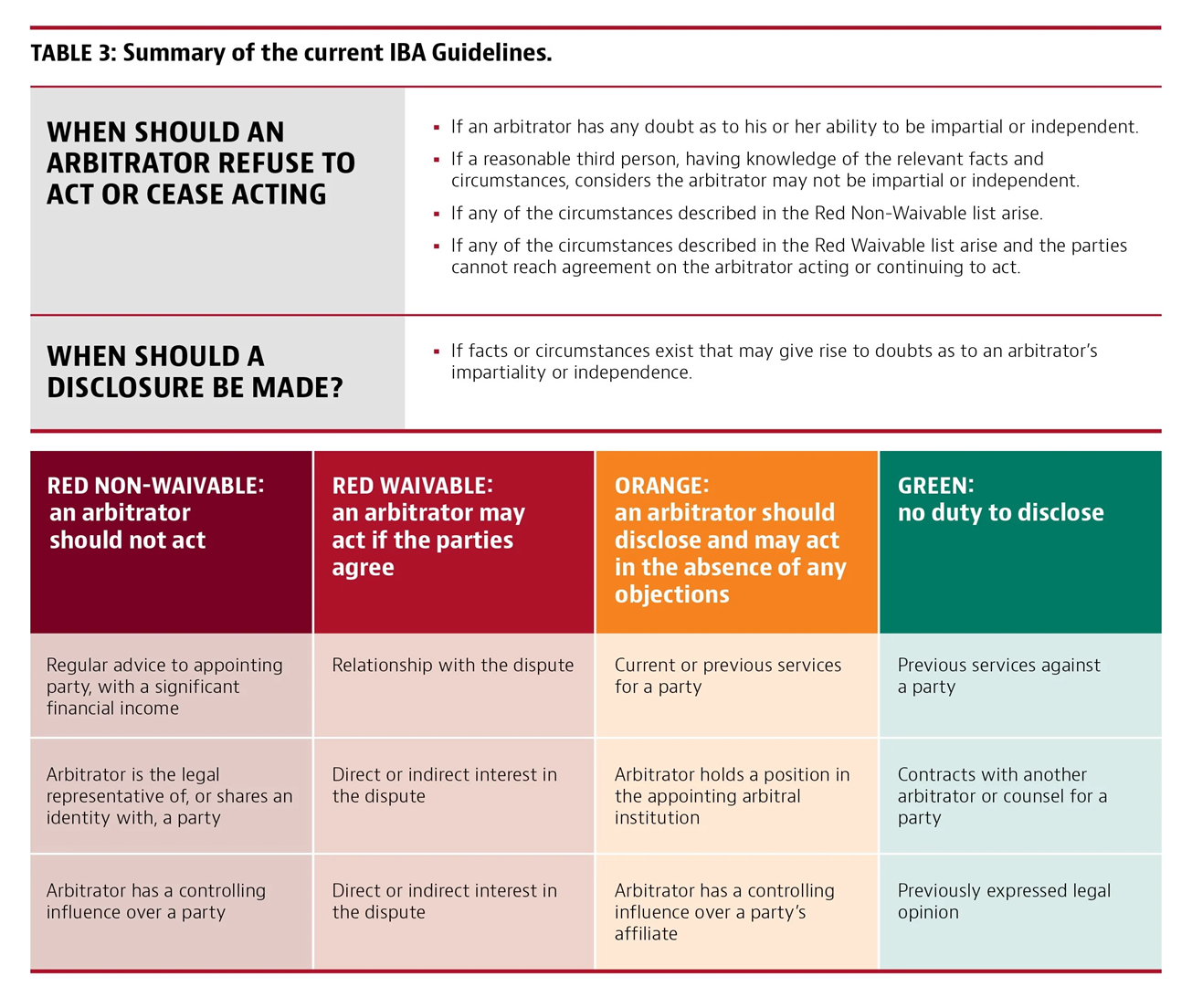

Slide 30
Chartered Institute of Arbitrators - Uganda Chapter
Plot 28A Golf Course Road,
0200 954 512 | +256 772 474 695
info@ciarbuganda.org
www.ciarb.org

