Slide 1

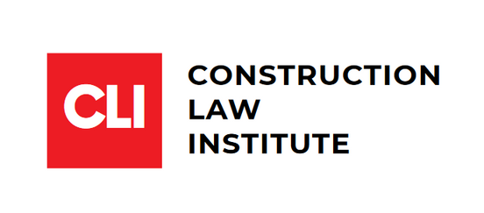
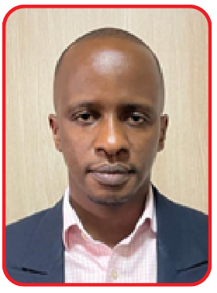
ROLE OF DISPUTE BOARDS IN DISPUTE AVOIDANCE & ADJUDICATION
ENG. BAKIZA IAN PAUL
BCiv (MUK), R. Eng, M.U.I.P.E

Slide 2
PROFILE OF THE SPEAKER
Eng. Bakiza is a Registered Professional Civil Engineer and Construction Claims Practitioner with over a decade experience in Project and Construction Claims Management, Engineering Design, Construction Programming, Public Procurement Contracting and Environmental and Social Safeguards Management.
He is a Professional Member/Corporate Member – _Uganda Institution of Professional Engineers (UIPE) , Registered Member – Engineers Registration Board, Member – Institute of Construction Claims Practitioners (ICCP), Member of Faculty – International Centre for Mediation and Arbitration Kampala (ICAMEK)
He also has extensive demonstrable experience managing large scale, complex engineering infrastructure projects and programs, construction claims mediation, adjudication.
He possesses extensive knowledge of international construction contract formats such as FIDIC conditions of Contract, PPDA conditions of contract, EDF conditions of contract and project management procedures through managing various development partner financed projects such as European Union, African Development Bank and the International Development Agency/World Bank.

Slide 3
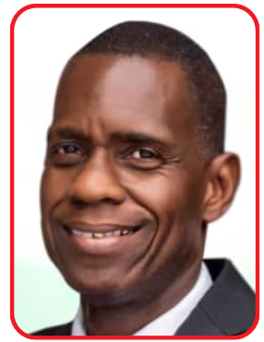
PROFILE OF THE MODERATOR:
RSU PHILIP KAHERU, FCIArb
Philip is an arbitrator and adjudicator. He holds a BSc.(Hons) Quantity Surveying from University Of Reading, England, United Kingdom and a PgD International Construction Contracts Universite’ De Paris II, Paris, France. Mr. Philip Kaheru is an experienced Quantity Surveyor with over 15 years’ experience in active field work.
He has participated on small, medium to large projects and his work has involved all aspects of quantity surveying that included preparation of pre-tender estimates, tender documents, feasibility and scheme design estimates and preparation of tender interviews, involving reporting to the client and selection of bidders, valuations and costs estimates, site meetings and overall cost control of projects.
He is a distinguished member of several prestigious professional organizations, including the Royal Institution of Chartered Surveyors (FRICS), the Institution of Surveyors of Uganda (FISU), the Chartered Institute of Arbitrators (FCIArb), and the Dispute Resolution Board Foundation (DRBF). Additionally, he is a Registered Surveyor of Uganda (RSU).

Slide 4

What are Disputes and When do they Arise)?
Disputes in the construction industry refer to disagreements or conflicts between parties involved in a project regarding contractual obligations, performance, or other project-related issues.
Disputes typically arise at any point in the project lifecycle

Slide 5
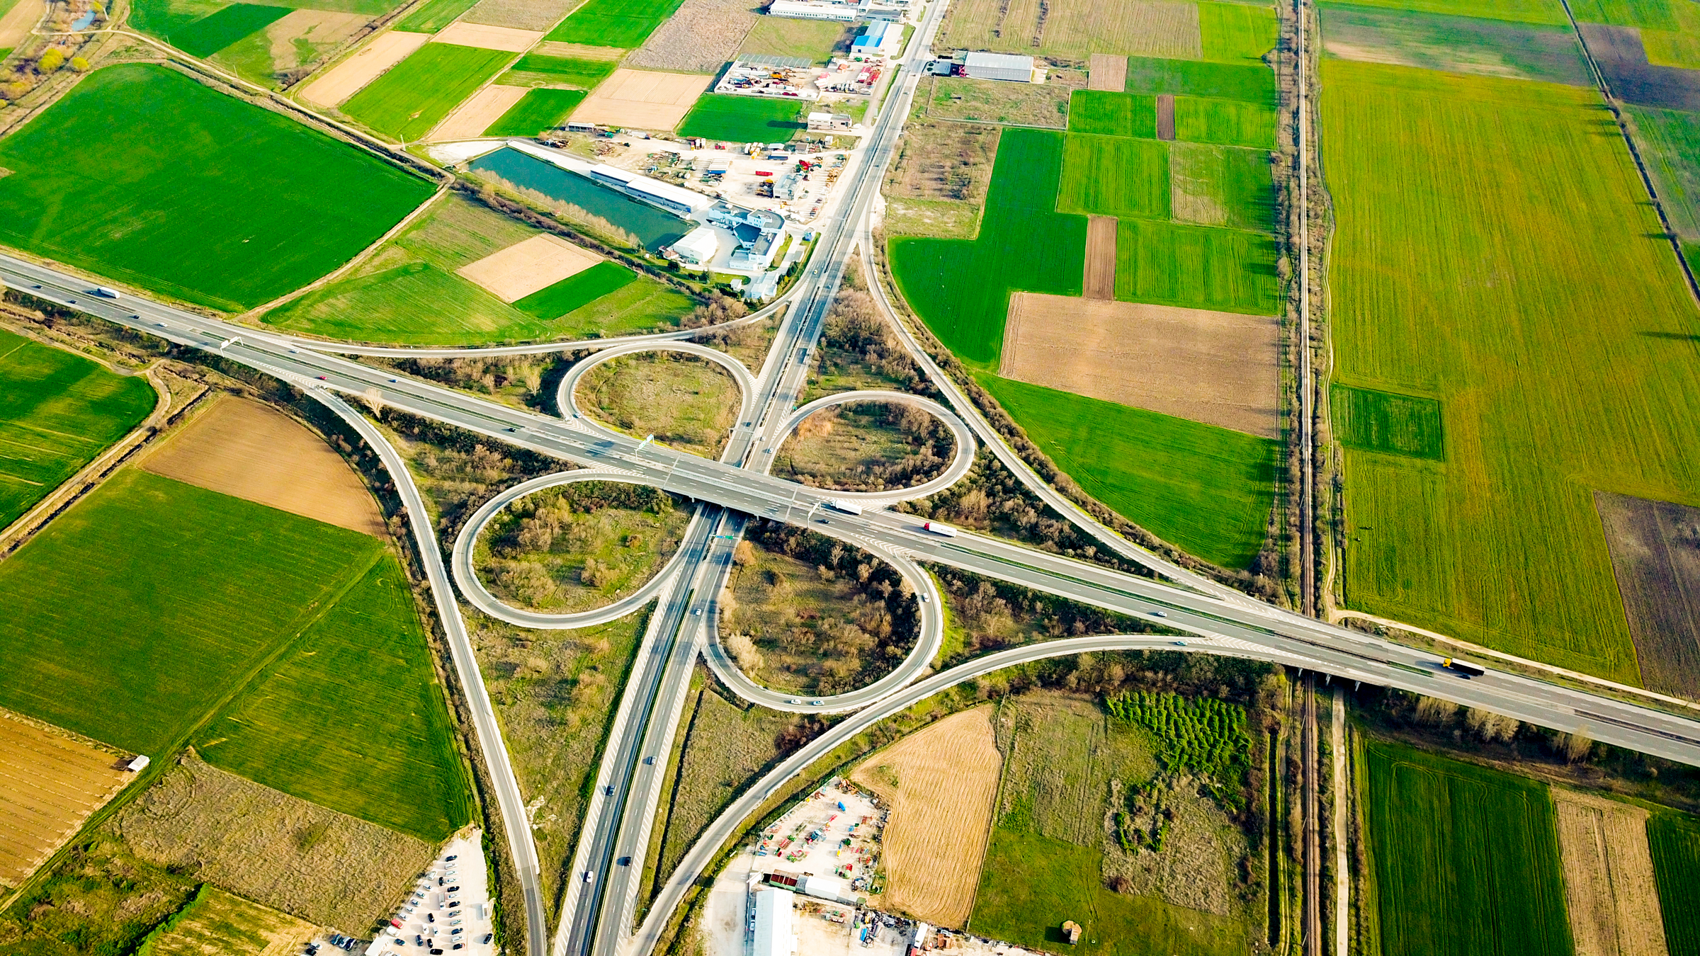
Common Causes of Disputes in Construction Projects
  1. Contractual Interpretation
  2. Scope of Work
  3. Project Delays
  4. Payment Issues
  5. Quality of Work
  6. Variations and Change Orders
  7. Site Conditions
  8. Performance Issues

Slide 6

What are Dispute Boards (DBs)?
A Dispute Board is an independent panel of experts formed at the start of a project to help prevent disputes and resolve issues that arise during the course of the project.
Types of Dispute Boards
- Dispute Review Boards (DRB) : Provide non-binding recommendations.
- Dispute Adjudication Boards (DAB) : Provide binding decisions.
- Dispute Avoidance /Adjudication Board (DAAB) : Offer both recommendations and decisions.

Slide 7

Dispute Boards in FIDIC Contracts
FIDIC Overview- The International Federation of Consulting Engineers (FIDIC) is known for its standard form construction contracts.
DBs in FIDIC- Integral part of the FIDIC Red, Yellow, and Silver Books.
- DABs typically provide binding decisions unless referred to arbitration.
FIDIC Clause 20
- Details the procedures for dispute resolution through DABs.
- Emphasizes the proactive role of DBs in preventing disputes.

Slide 8

Dispute Boards in PPDA Contracts
PPDA Overview
- Public Procurement and Disposal of Public Assets (PPDA) Act governs public procurement in various jurisdictions.
DBs in PPDA Contracts- Often mandated to ensure fairness, transparency, and efficiency.
- DBs help in resolving disputes quickly to avoid project delays and cost overruns.

Slide 9

Functions of Dispute Boards
Preventive Role
- Regular site visits and meetings.
- Early identification of potential issues.
- Informal advice to avoid disputes escalating.
Dispute Resolution Role
- Formal hearing and review of disputes.
- Issuing recommendations or binding decisions.

Slide 10
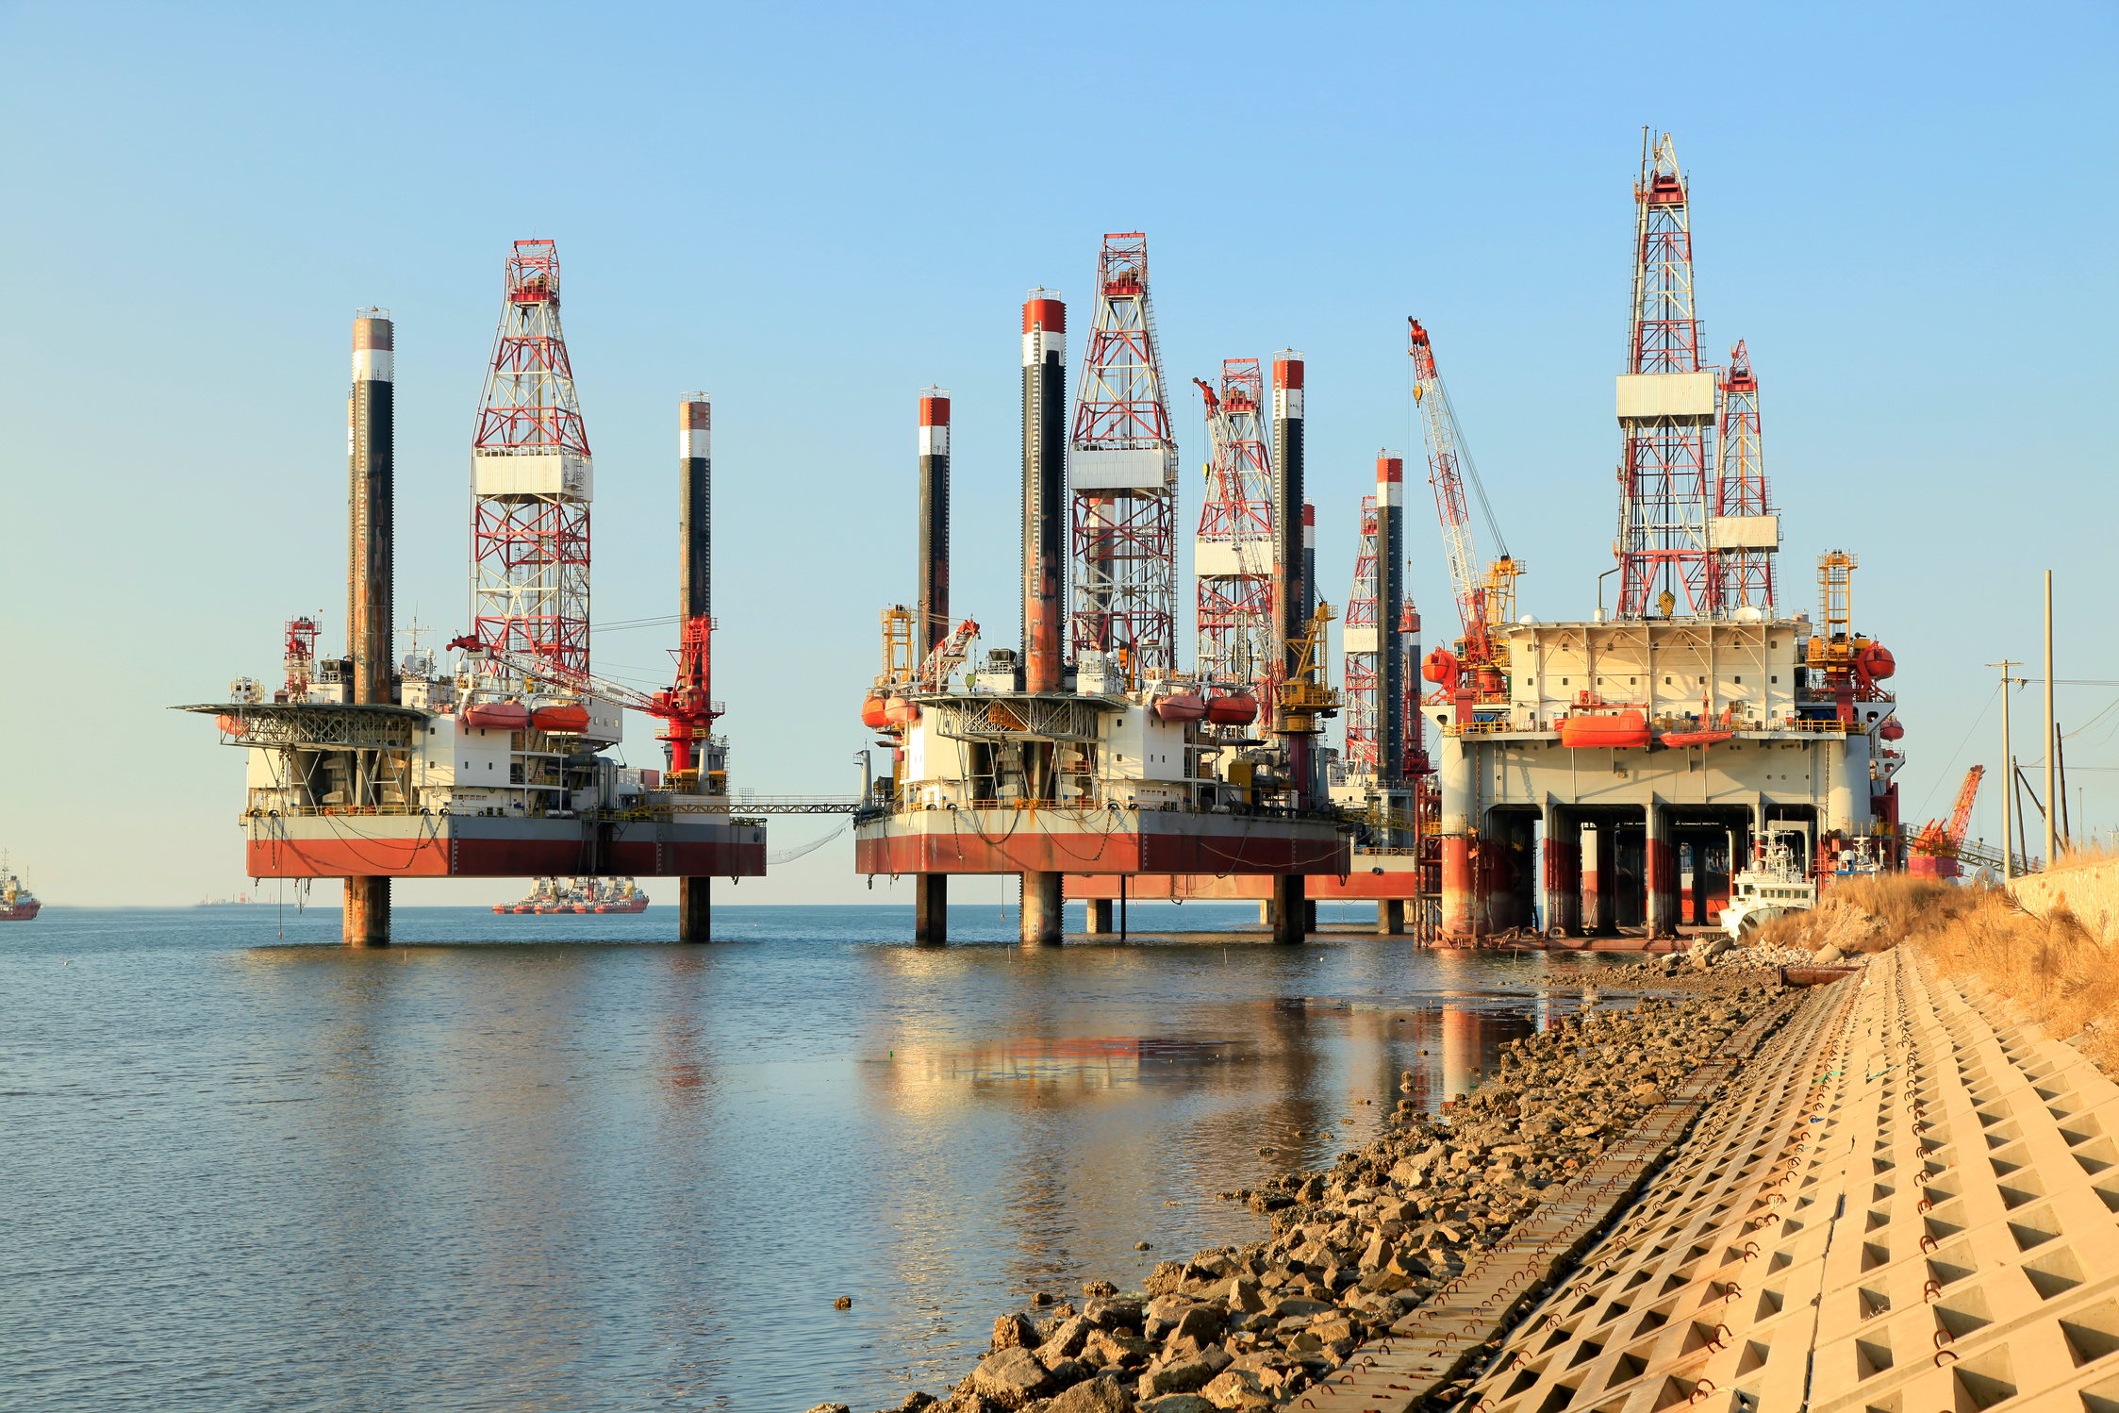
Benefits of Dispute Boards
Time and Cost Efficiency
- Early resolution of disputes prevents delays.
- Reduces the need for lengthy arbitration or litigation.
Expertise and Objectivity
- Composed of experienced industry professionals.
- Provides impartial and informed decisions.
Enhances Project Relationships- Encourages collaboration and communication.
- Maintains focus on project completion.

Slide 11
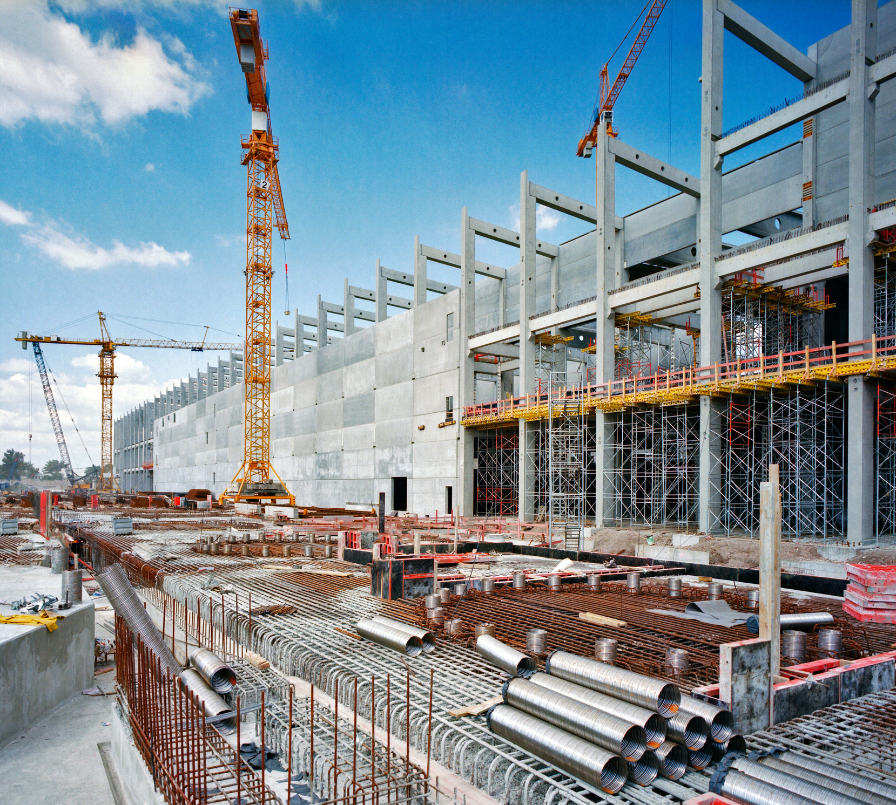
Implementation of Dispute Boards
Selection of DB Members
- Expertise in relevant fields (engineering, law, etc.).
- Independence and impartiality.
Contractual Provisions
- Clear terms in the contract regarding the scope and authority of the DB.
- Defined procedures for dispute submission and review.
Regular Engagement- Scheduled site visits and meetings.
- Prompt attention to emerging issues.

Slide 12
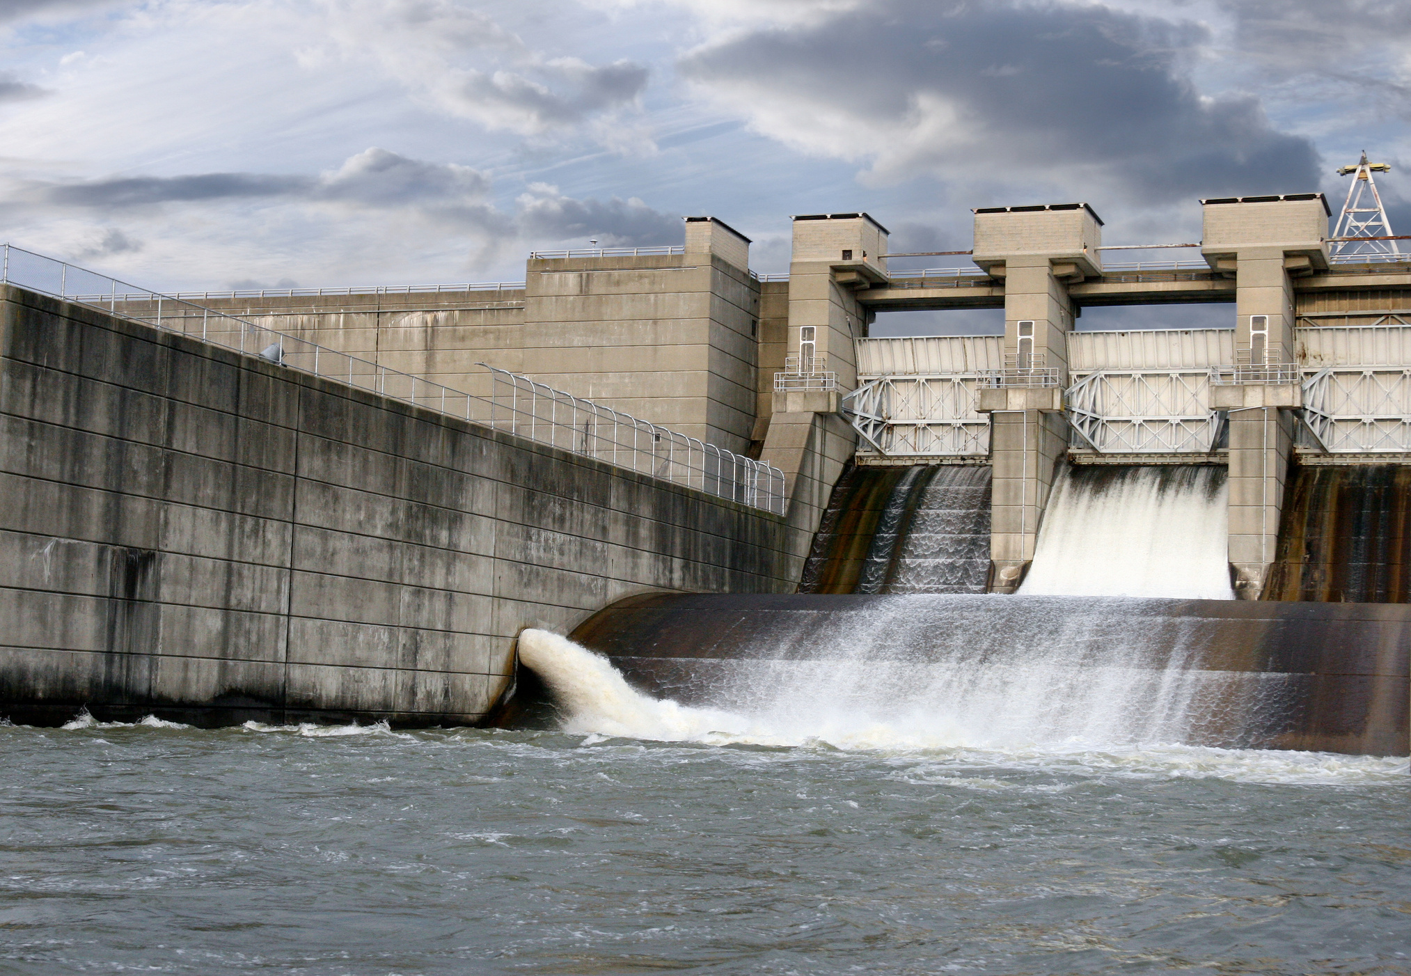
Challenges and Considerations
Challenges
- Ensuring impartiality and independence.
- Costs associated with maintaining a DB.
- Acceptance of DB decisions by all parties.
Considerations for Success- Comprehensive training for DB members.
- Clear and concise contract clauses.
- Strong commitment from all stakeholders.

Slide 13





Thank You!
Contact:
0700 521 398 / 0789 519 111 / 0700 597 888
Email:
info@constructionlawinstitute.com
Follow us

